Slide 1


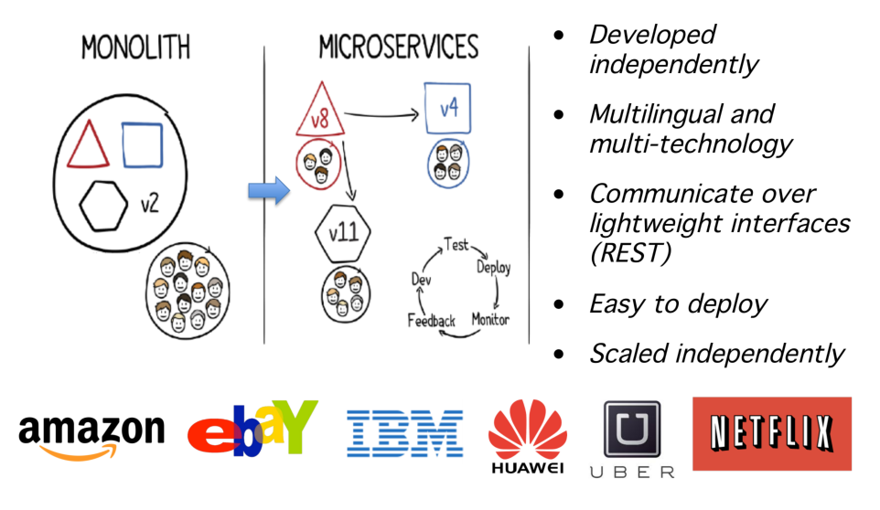
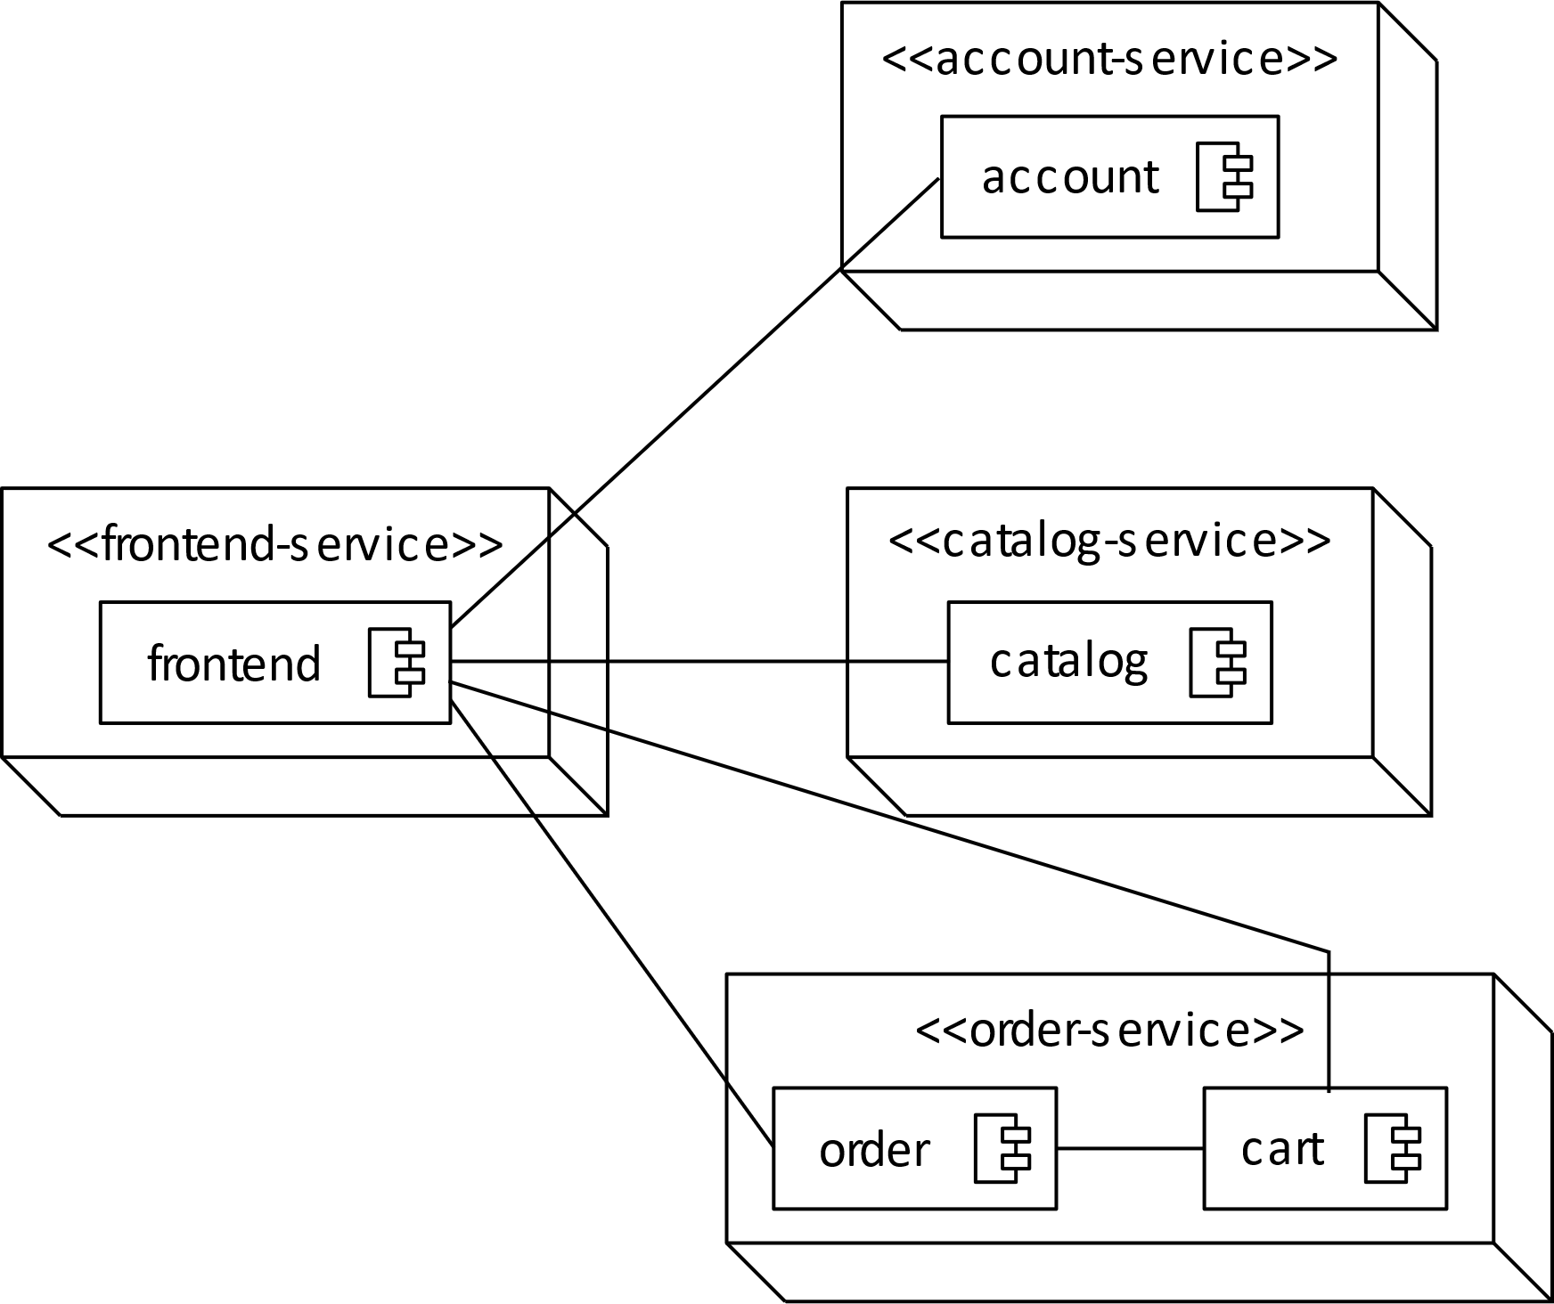
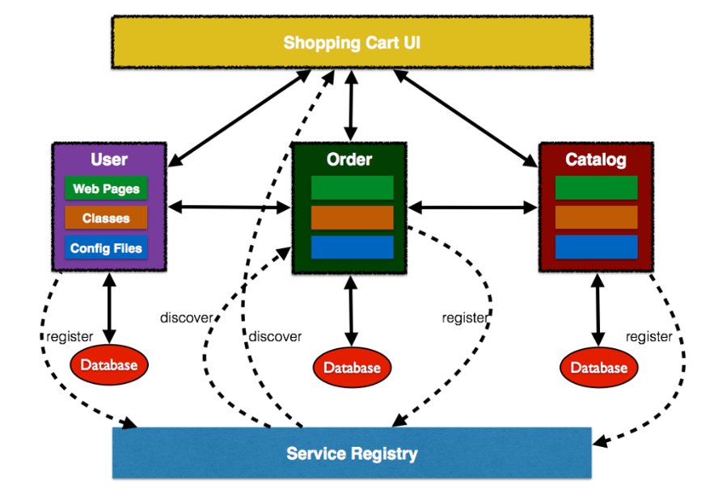
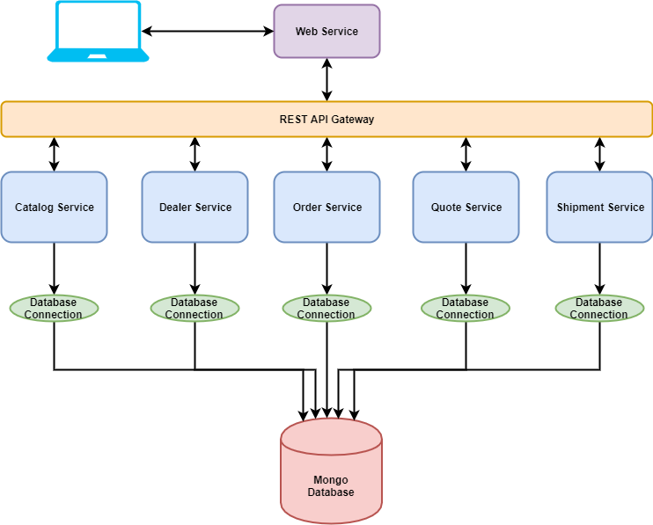
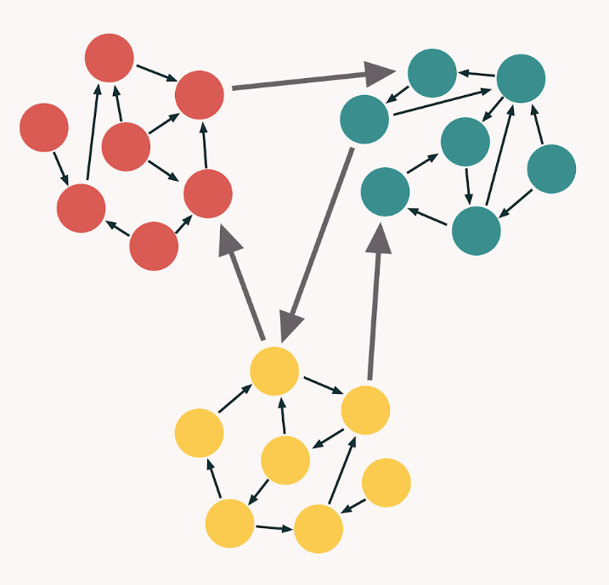
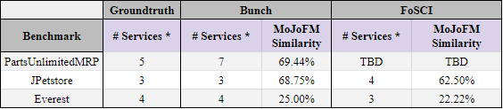
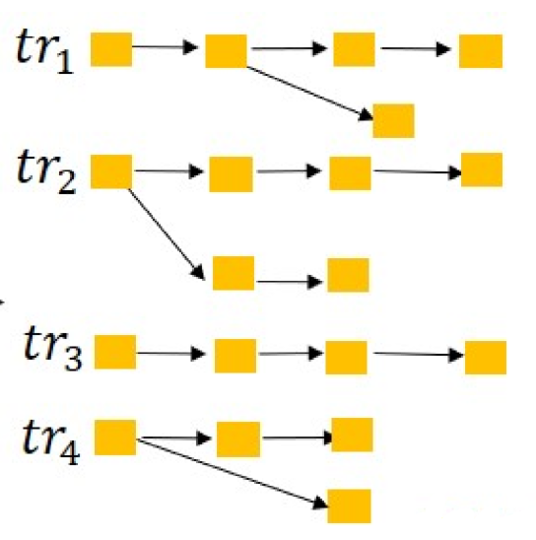
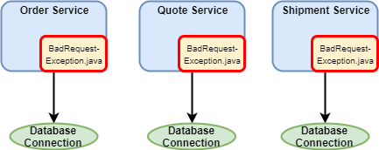

A Comparative Analysis of Microservice Extraction Techniques
Lisa Kirby¹, Julia Rubin¹, Ao Tang¹, Will Zhang¹, Yee-Kang Chang², Cindy High³
¹ The University of British Columbia, Vancouver, Canada
Contact: hjfhsdfhs@kdhfkshsk
What are microservices?
Problem:
Manually splitting applications into microservices requires time, effort, & architectural expertise.
Can we automate this process?
independently deployable + scalable components
multilingual & multi-technology
communicate over lightweight interfaces
Most prominent techniques
Subjects: Apps with both monolithic and microservice-based versions
Static-Analysis:
Bunch Hill Climbing
(Mancoridis et al.)
JPetstore (Java EE)
github.com/mybatis/jpetstore6
Everest (Java EE)
github.com/arun-gupta/microservices
PartsUnlimitedMRP (Java & C#)
github.com/microsoft/PartsUnlimitedMRP
Core Design Principle:
High Cohesion, Low Coupling
Results
Dynamic-Analysis:
FoSCI
(Jin et al.)
* Does not include frontend ** MoJoFM: calculates class-level distance function
Core Design Principle:
Single Responsibility
Why is the similarity so low?
Lessons learned
Ground truth version: intentional code duplicates (exceptions, database connections, factories)
Microservice version: adding / modifying classes to support microservices (handling communication)
Small benchmarks → small error are “costly”
“Legitimate” exception to the high cohesion / low coupling rule are hard to handle
Microservices rely on framework, e.g., for communication. Supporting code is not available in the monolith and needs to be generated from scratch
Architecture-based decomposition misses consideration related performance, deployment constraints, etc.
Notes:
TEMPLATE IS FULLY CUSTOMIZABLE. BOXES AND PLACEHOLDERS CAN BE REMOVED. COLOURS CAN BE CHANGED.
UBC LOGO MUST REMAIN TOP LEFT. UBC BRANDING BAR AT THE BOTTOM CAN BE DELETED IF DESIRED.

